Slide 1
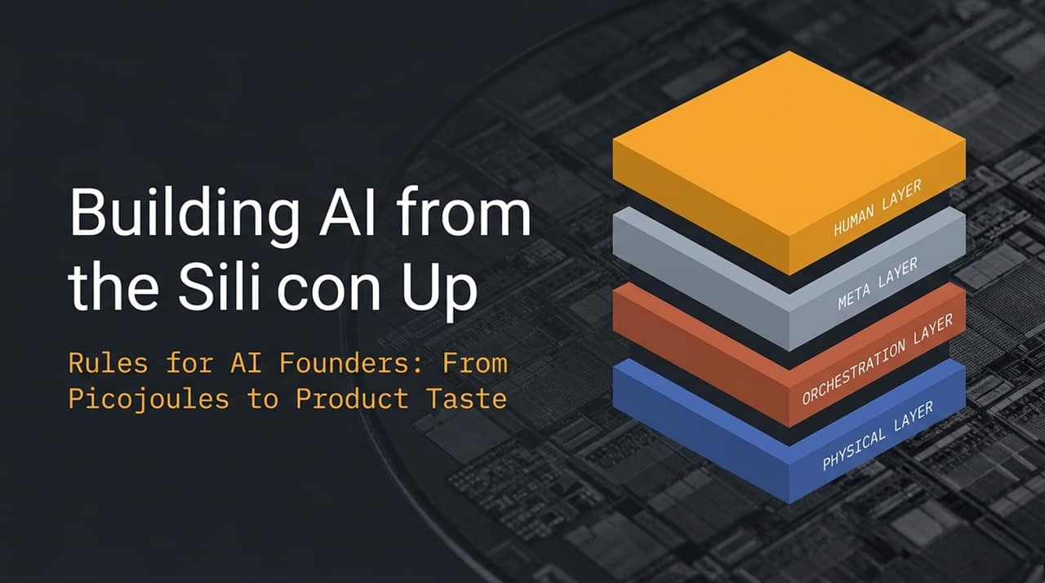
Notes:
Introduction: "Welcome everyone. Today we’re talking about building AI systems from first principles—literally from the physics of silicon all the way up to human taste."
Connecting to the Talk: "As Jeff Dean recently highlighted at YC, the landscape of AI engineering is shifting rapidly. We are moving beyond just training bigger models to thinking about the entire full-stack system."
4-Layer Framework Overview:
Physical Layer: The fundamental constraints of physics, hardware energy, data movement, and chip architectures.
Orchestration Layer: Context engineering, agent workflows, and multi-agent search systems.
Meta Layer: Automated scientific experimentation and self-improving loops.
Human Layer: Founder problem selection, writing precise specifications, and cultivating taste.
Transition: "Let’s start at the bottom of the stack—the Physical Layer—and look at how historical shifts in computer engineering inform where AI hardware is going today.
https://www.youtube.com/watch?v=CxXgV54KzpQ

Slide 2
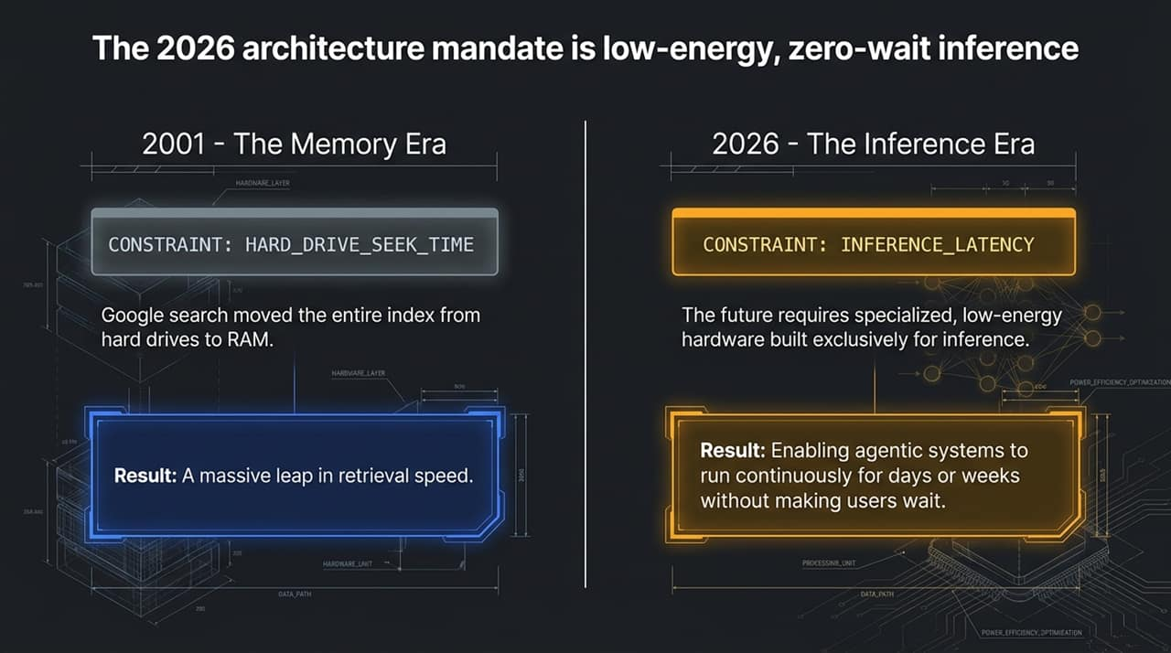
Notes:
The Historical Parallel (2001): "Back in 2001, Google Search was bottlenecked by disk seek time. Jeff Dean and Sanjay Ghemawat realized that if they loaded the entire search index directly into RAM across all machines, they could eliminate hard drive latency and transform web search forever."
The 2026 Shift (Inference Era): "Fast forward 25 years: our bottleneck today is inference latency and energy cost. Everyone in AI is used to waiting for model responses, but waiting kills agency."
Key Takeaway: "To unlock true agentic systems—agents that run continuously for days or even weeks without stopping—we need specialized, low-energy hardware designed purely for inference. When latency drops by 50x, user experience and agent capabilities undergo a phase change.

Slide 3
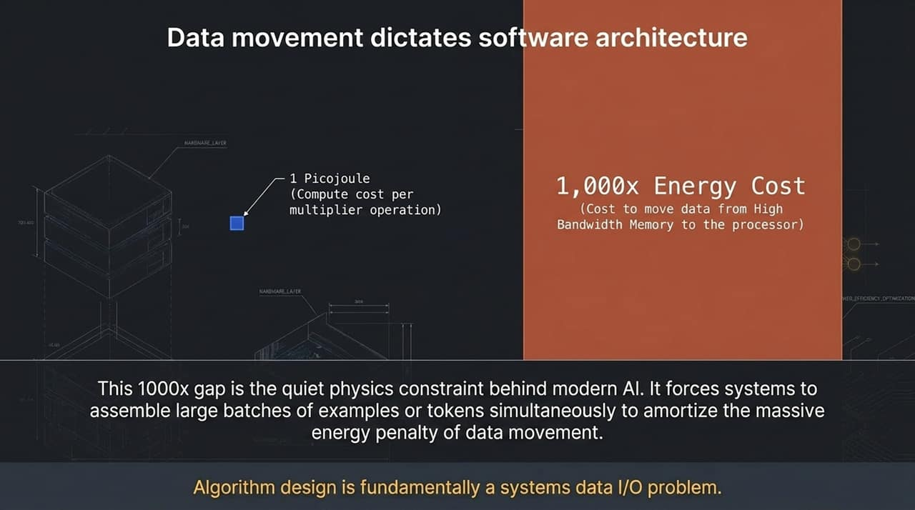
Notes:
The Core Physics Principle: "Here is the quiet physics constraint behind all modern AI software: doing a single math multiplication takes about 1 picojoule of energy. But bringing that data from High Bandwidth Memory into the processor chip costs 1,000 times more energy."
Implications for AI Algorithms: "Why do we use large batch sizes during training and inference? Not because the model requires it mathematically, but because systems need to amortize that 1,000x energy penalty of data movement across multiple tokens or examples."
Founder/Builder Takeaway: "Many problems that engineers call 'model problems' or 'algorithm problems' are actually data I/O and energy movement problems. As Jeff Dean points out, minimizing data movement and designing around batch-size constraints is how you achieve radical hardware efficiency.

Slide 4
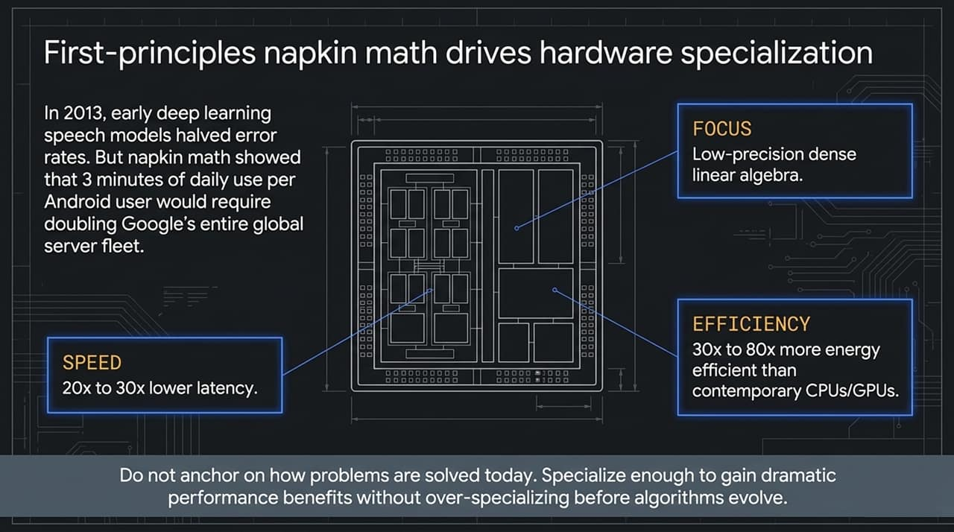
Notes:
The Origin Story: "In 2013, Google introduced deep learning for speech recognition. It halved error rates—the equivalent of 20 years of research overnight. But Jeff Dean ran a quick back-of-the-envelope calculation: if every Android user spoke to their phone for just 3 minutes a day, Google would have to double its entire global server footprint."
First-Principles Solution: "Instead of buying millions of CPUs, they built a specialized custom chip: the TPU (Tensor Processing Unit). By specializing solely in low-precision dense linear algebra—and removing the ability to run general software like Chrome or Word—they achieved 30x to 80x better energy efficiency and 20x to 30x lower latency."
Lesson for Founders: "Do not anchor on how problems are solved today. Do napkin math from first principles. Specialize enough to gain order-of-magnitude performance benefits without over-specializing before algorithms evolve.

Slide 5
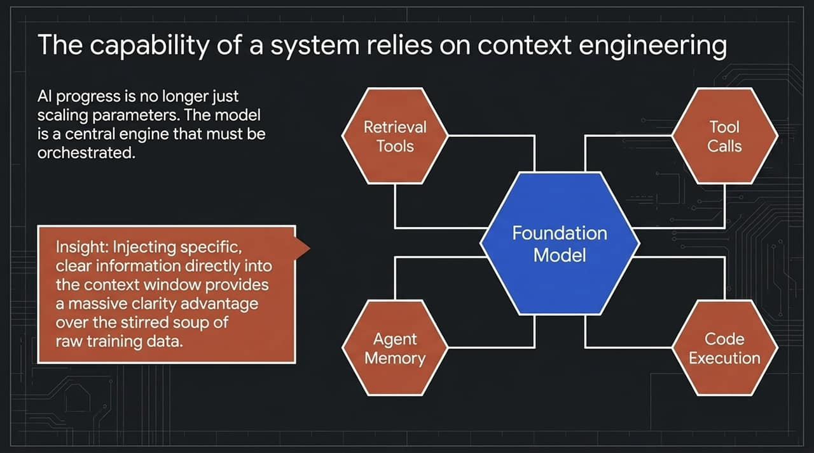
Notes:
Moving Beyond Parameter Scaling: "AI progress is no longer just about making models bigger or throwing trillions more tokens into pre-training. Today, the foundation model acts as a central reasoning engine inside a broader system."
The 'Stirred Soup' Analogy: "When a model learns during pre-training, trillions of tokens are stirred together into a parameter soup. That knowledge can be fuzzy or implicit. But when you perform Context Engineering—injecting precise, real-time data directly into the context window via RAG, tools, or memory—the model receives direct, razor-sharp clarity."
Democratization for Startups: "This is where small teams win. You don't need $100M of GPUs to pre-train models. You can use standard model APIs and excel at context engineering, tool integration, and agentic workflows.

Slide 6
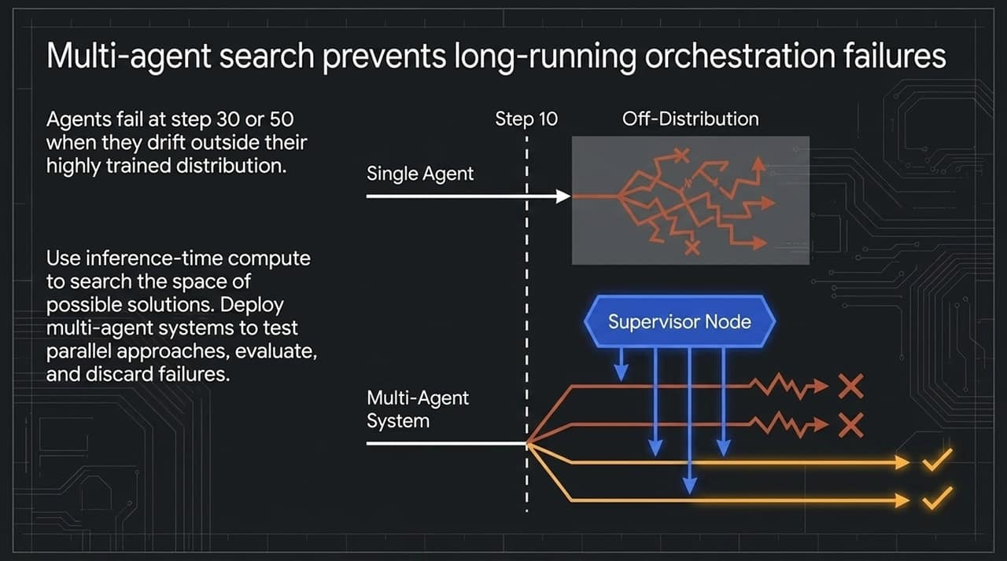
Notes:
The Problem with Long-Running Agents: "Have you ever built an AI agent that works great for 5 steps, but goes completely off the rails by step 30 or 50? Why does that happen? Because as the execution sequence grows, the agent drifts outside its highly trained training distribution."
Inference-Time Compute & Search: "To fix this, we move from single-threaded agent loops to multi-agent search systems using inference-time compute."
How It Works: "Instead of hoping one agent gets it right across 50 steps, deploy multiple sub-agents in parallel. A supervisor node evaluates progress, prunes hallucinated or failing paths, and doubles down on successful trajectories.

Slide 7
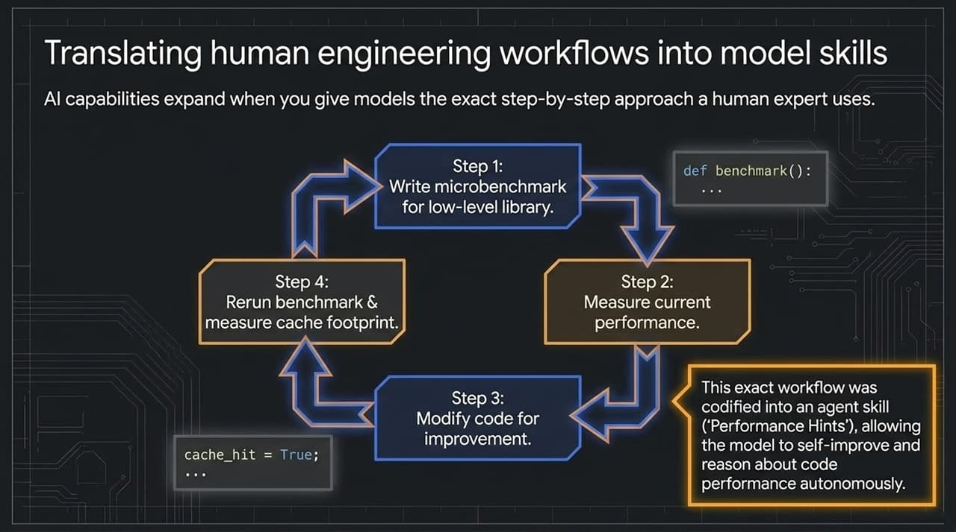
Notes:
How to Teach Agents Complex Skills: "How do we teach an LLM to perform high-level engineering tasks? By explicitly codifying human workflows into step-by-step agent skills."
Real Google Case Study: "Jeff Dean and Sanjay Ghemawat frequently write low-level C++ performance optimizations. They formalized their exact process—write benchmark, measure performance, modify code, measure cache footprint—and published a guide called 'Performance Hints'."
Result: "They fed this exact workflow definition to their coding models as a custom skill. The agent could then autonomously cycle through code optimization loops, benchmarking its own iterations and achieving expert-level performance improvements.

Slide 8
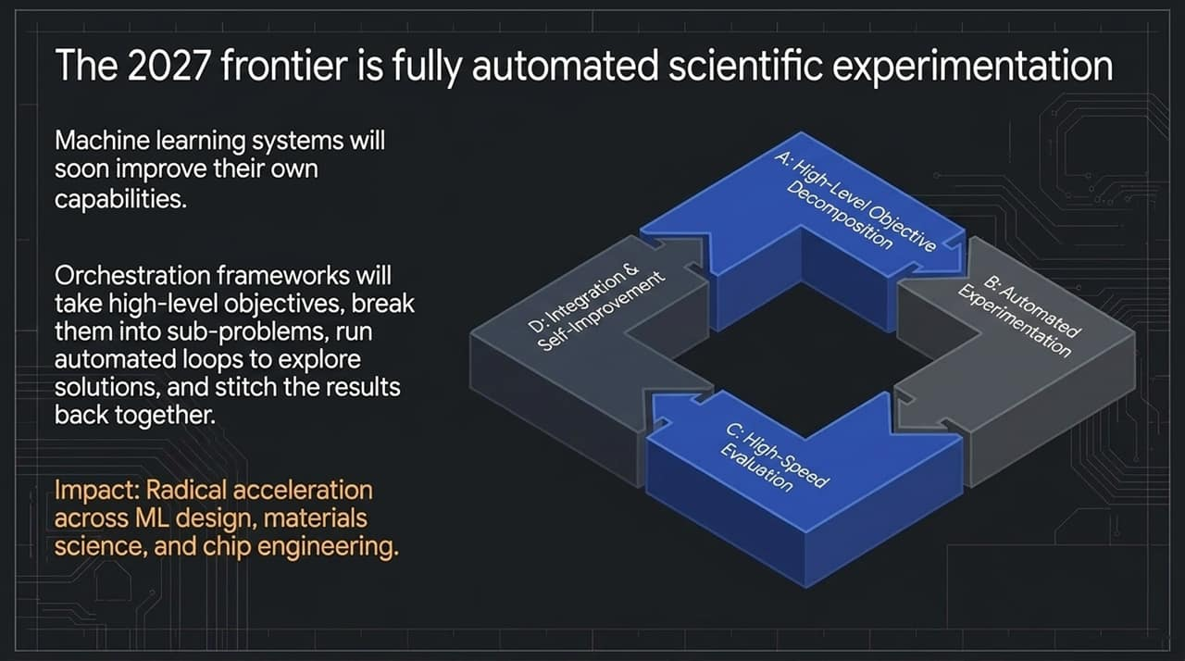
Notes:
The 2027 Prediction: "Looking ahead to 2027, Jeff Dean predicts a massive shift toward fully automated scientific and engineering experimentation loops."
The Closed Scientific Loop: "System architecture will work like this:
Orchestration frameworks take a broad goal and decompose it into sub-problems.
Agents propose hypothesis-driven solutions and generate experiment variants.
High-speed evaluators run tests.
Successful results are merged back into the base system to drive self-improvement."
Cross-Domain Application: "This isn't limited to software development. It applies directly to machine learning model architecture search, drug discovery, materials science, and semiconductor chip design.

Slide 9
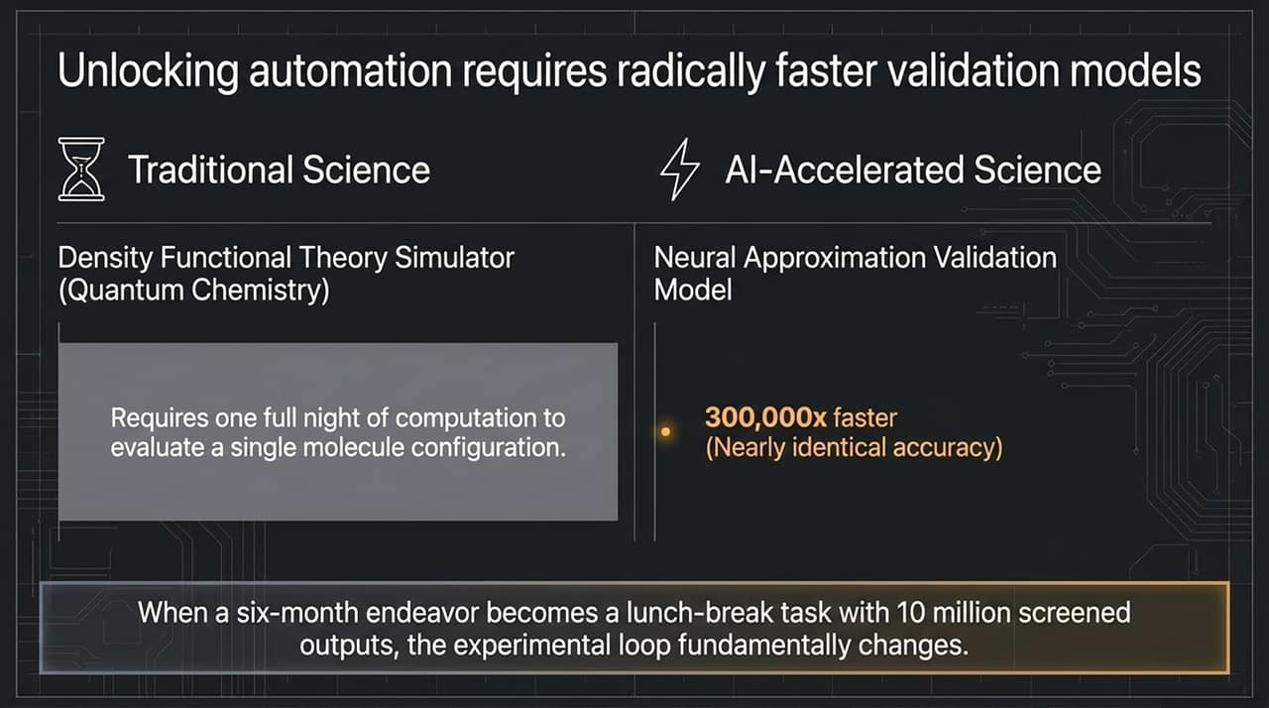
Notes:
The Bottleneck in Automated Loops: "Automated experimentation is only as fast as your evaluation loop. If evaluating an experiment takes 12 hours, your agentic system will stall."
The Neural Proxy Breakthrough: "Consider quantum chemistry: simulating a single molecular structure used to take a full night on a supercomputer cluster. Researchers trained a neural network proxy model on historical simulation inputs/outputs. The neural evaluator ran 300,000 times faster with almost zero loss in accuracy."
The Paradigm Shift: "Screening 10 million chemical configurations used to take 6 months of compute setup. Now it can be run during a lunch break. Whenever you make validation 100,000x faster, discovery changes fundamentally.

Slide 10
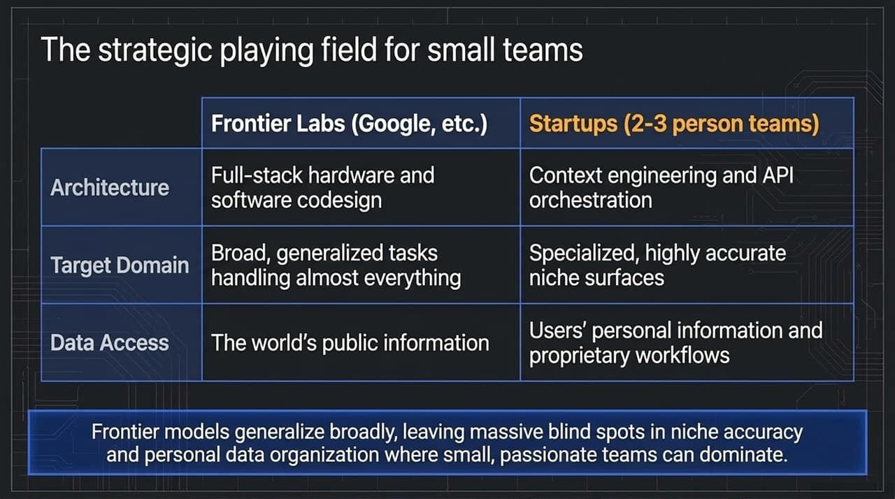
Notes:
Frontier Labs vs. Startups: "Where can a 2-person startup win against tech giants with multi-billion-dollar clusters?"
Frontier Lab Advantage: "Labs like Google or OpenAI excel at full-stack hardware/software codesign, generalized foundation models, and indexing public internet data."
Startup Advantage: "Startups excel at specialized domain accuracy, context orchestration, and accessing private, personal, or proprietary enterprise data."
The Blind Spot: "Google organizes the world’s public information, but they don't have access to your personal files, private company workflows, or hyper-niche industry domain data. That blind spot is where agile startup teams can build dominant, highly defensible products.

Slide 11
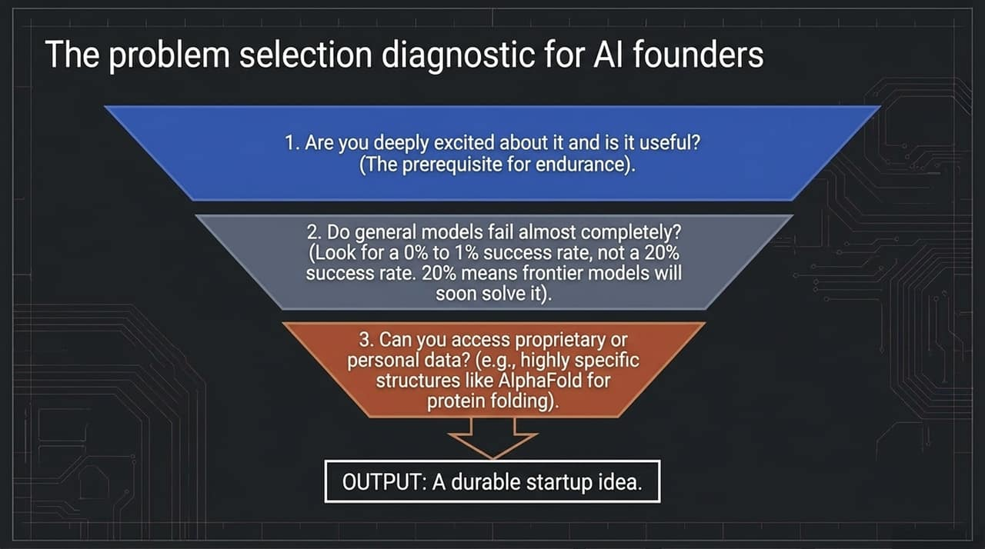
Notes:
How Founders Should Evaluate Ideas: "Jeff Dean outlines a 3-question diagnostic to test if a startup idea is durable:"
Criterion 1 (Founder-Market Fit): "Are you super excited about it, and will it be genuinely useful?"
Criterion 2 (The 1% Rule): "Do general models fail completely at it (0% to 1% success rate)? Beware of problems where frontier models currently get 20% accuracy—a 20% success rate means the next model version will likely solve it out-of-the-box in 6 to 12 months. Look for tasks where general models score 0%."
Criterion 3 (Data Moat): "Do you have access to proprietary data or specific structural formats (like AlphaFold had with protein folding data)?"

Slide 12
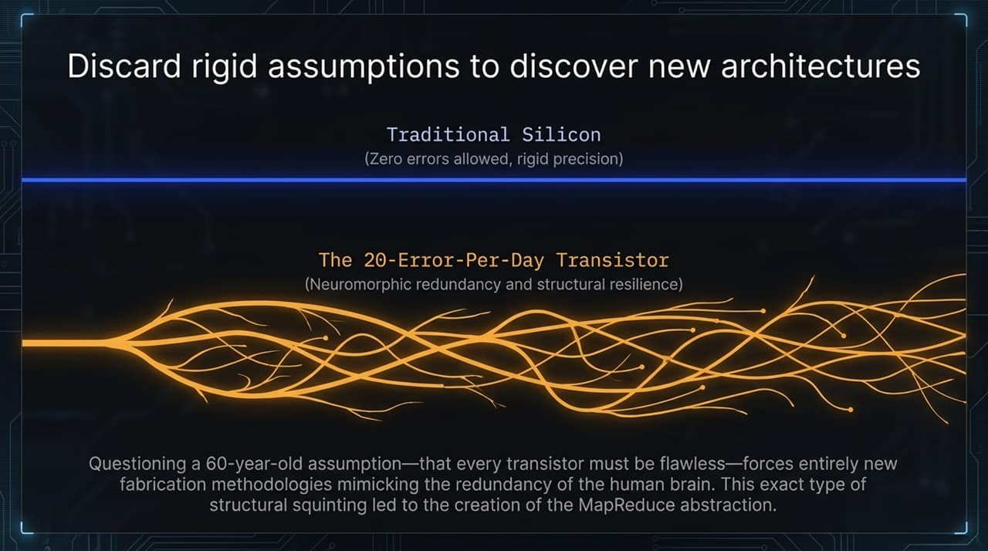
Notes:
Challenging 60-Year-Old Assumptions: "For 60 years, chip design has assumed that every transistor must be 100% flawless with zero bit flips allowed."
A Radical Thought Experiment: "What if you deliberately designed hardware using cheap, unreliable transistors that experience 20 errors per day, mimicking the biological pathways of the human brain?"
Historical Example (MapReduce): "This exact 'structural squinting' is how Jeff Dean and Sanjay Ghemawat invented MapReduce. Instead of requiring flawless hardware, they assumed servers and hard drives would constantly fail, building fault tolerance into the software layer. Revisiting fundamental assumptions is where true architectural leaps come from.

Slide 13
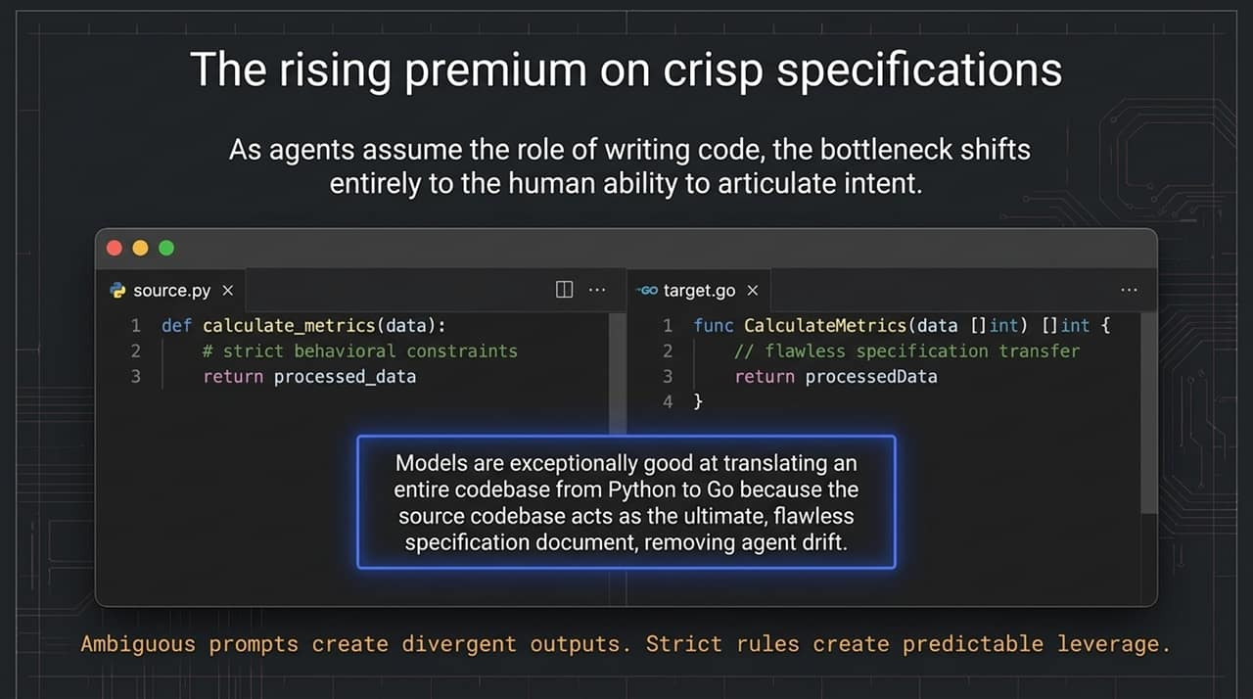
Notes:
The Shift in Software Engineering: "As autonomous AI agents take over writing raw code, human engineering doesn't disappear—it shifts up the stack. The bottleneck becomes the human ability to articulate clear intent."
Why Code Translation Works So Well: "Why are models exceptionally good at porting a complex Python codebase into Go? Because the original Python codebase acts as an unambiguous, flawless specification document with unit tests that leave zero room for agent drift."
Takeaway: "Vague prompts produce unreliable, divergent outputs. Crisp specifications and deterministic test setups give agents massive operational leverage.

Slide 14
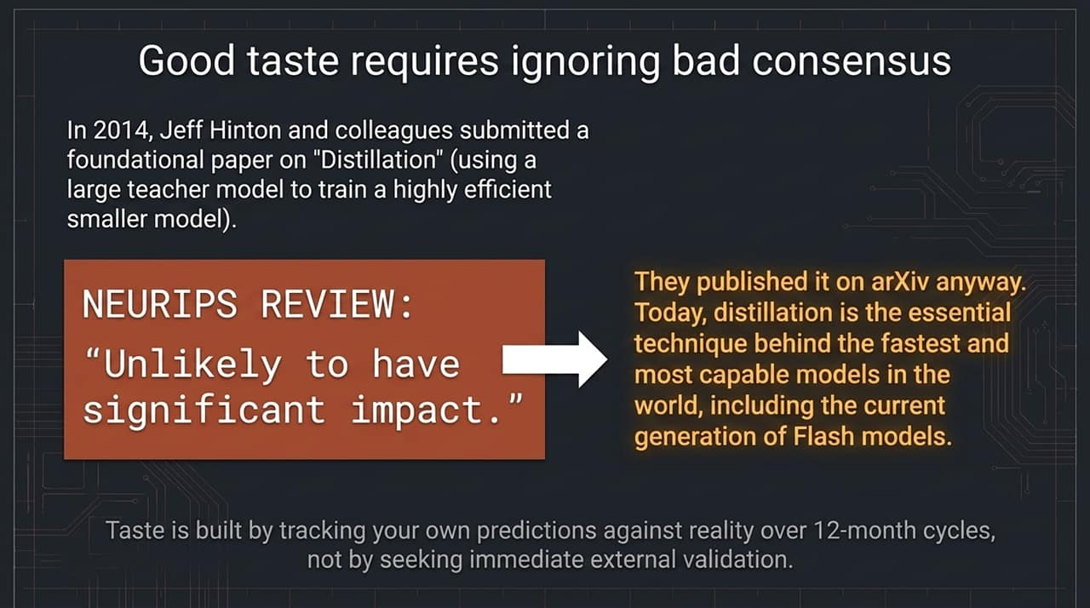
Notes:
The Peer Review Rejection: "In 2014, Geoff Hinton, Jeff Dean, and Oriol Vinyals submitted their seminal paper on Model Distillation (using a large teacher model to train a small, efficient student model) to NeurIPS. A peer reviewer rejected it, stating: 'Unlikely to have significant impact.'"
Persistence & Reality: "They published it on arXiv anyway. Today, distillation is the single most critical technique used to build lightweight, fast models like Gemini Flash."
Building Taste: "Product and research taste isn't built by seeking immediate consensus or external validation. Taste is cultivated by making clear predictions about technology, tracking those predictions against reality over 12-month cycles, and learning from the gaps.

Slide 15
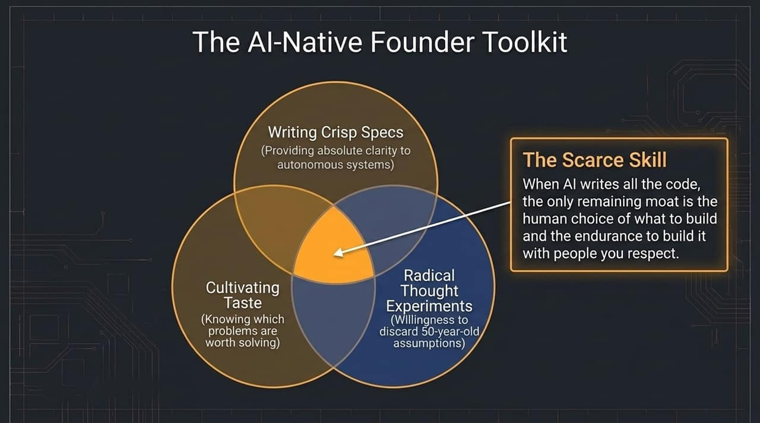
Notes:
Synthesizing the AI Founder Toolkit:
Crisp Specs: Clear, bounded instructions that prevent agent drift.
Radical Thought Experiments: Willingness to discard decades-old industry assumptions.
Cultivating Taste: Knowing which problems are truly worth solving.
The Ultimate Moat: "When commodity AI agents can write software instantly, code is no longer the moat. The scarce human skills are taste (choosing the right problem) and endurance (building with team members you admire and respect).

Slide 16
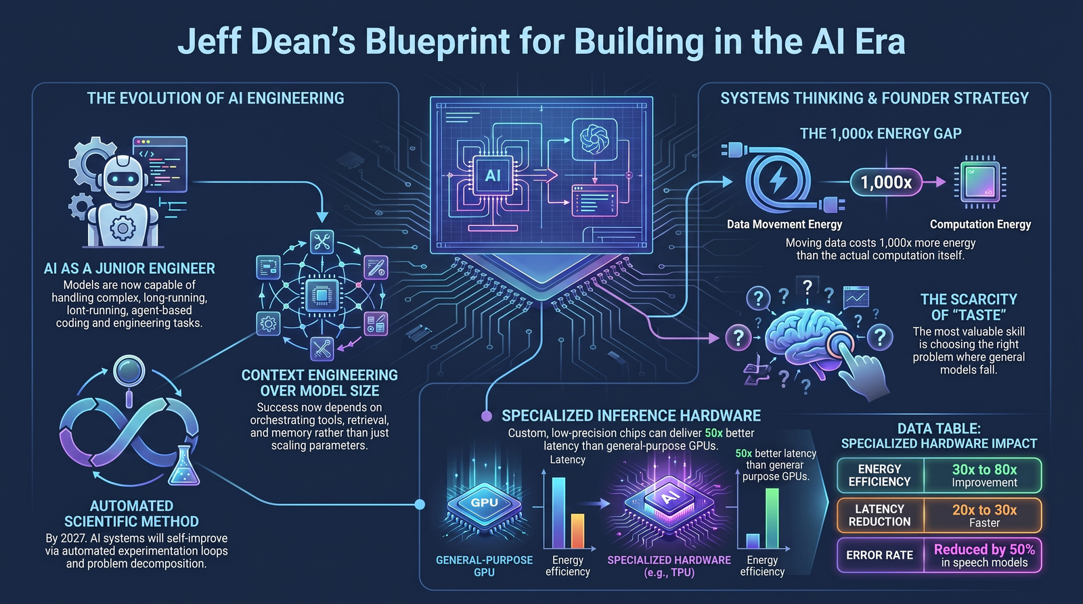
Notes:
Closing Recap: "To wrap up our deck, here is the executive blueprint for building AI systems from silicon up:"
Physical & Hardware Layer: "Acknowledge the 1,000x energy gap of data movement. Hardware specialization for low-precision inference is critical for zero-wait agentic experiences."
Orchestration & Systems Layer: "Treat AI models as reasoning engines within context-engineered systems. Use multi-agent parallel search and fast validation proxies to run long tasks reliably."
Founder & Product Strategy: "Target problem domains where general frontier models score 0% to 1%. Focus on clear specifications, leverage proprietary context, and cultivate product taste."
Q&A Transition: "Thank you! I’m now happy to take any questions on the presentation.

